Slide 1

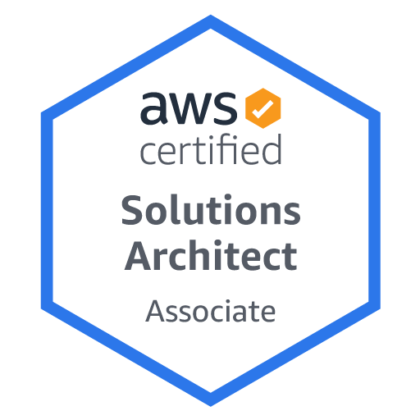
AWS Solutions Architect
-Bhanu Prakash

Slide 2

Welcome
We’re going to prepare for the Solutions Architect exam - SAA-C03
Basic IT knowledge is necessary to understand few things

Slide 3

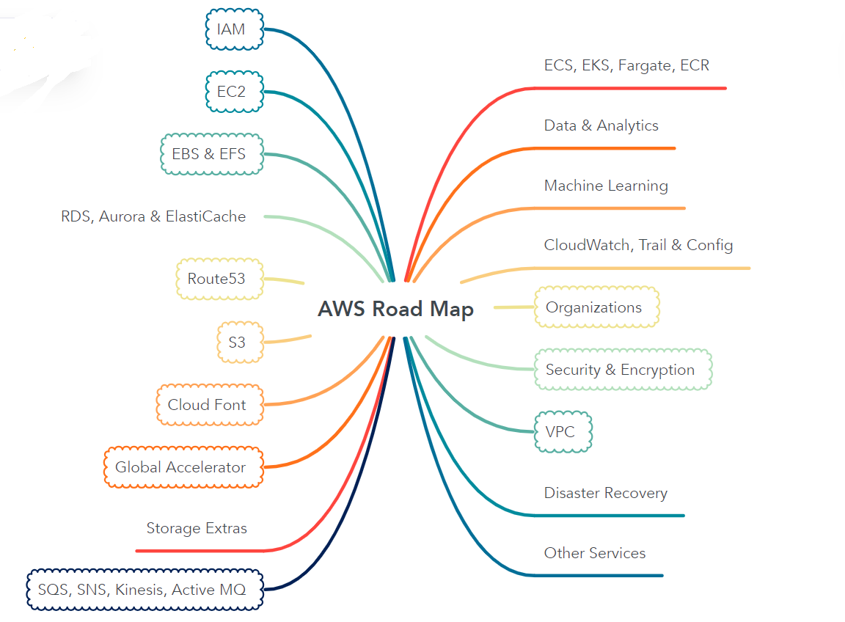

Slide 4

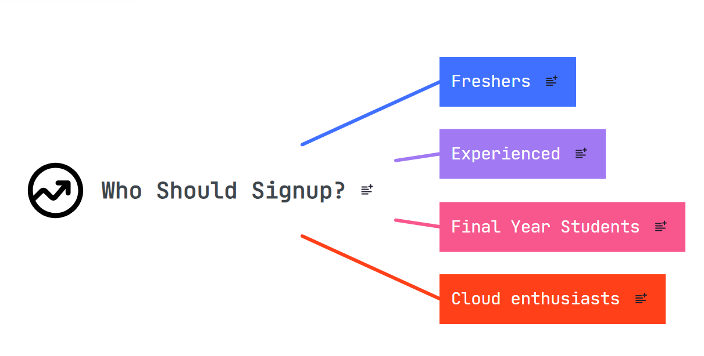
Elevate your IT Career

Slide 5

Cloud Computing & Cloud?
The term "the cloud" is a metaphor for the internet
The term originated in the early days of the internet as a way to describe the servers and networking infrastructure that make up the internet
The cloud metaphor emphasizes that the connections between devices and networks are hidden from the end user. This allows users to access services and resources without worrying about the technical details
On-demand delivery of IT Resources over the internet
Cloud has revolutionized IT over time

Slide 6
What’s AWS?
AWS (Amazon Web Services) is a Cloud Provider
They provide you with servers and services that you can use on demand and scale easily
AWS powers some of the biggest websites in the world
• Amazon.com
• Netflix

Slide 7
Cloud Deployment Models
Public Cloud
Private Cloud
Hybrid Cloud
Multi Cloud

Slide 8
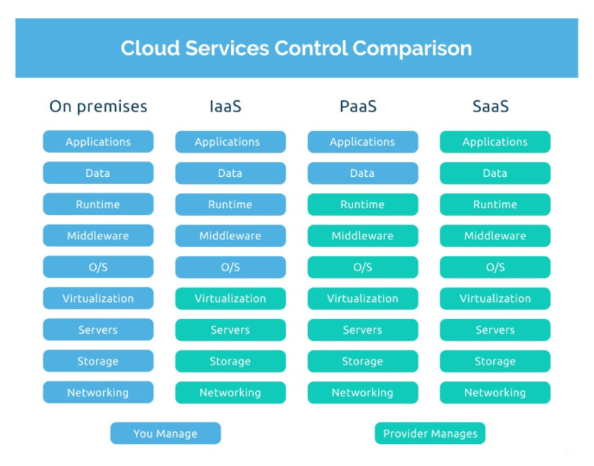
Cloud Service Models

Slide 9

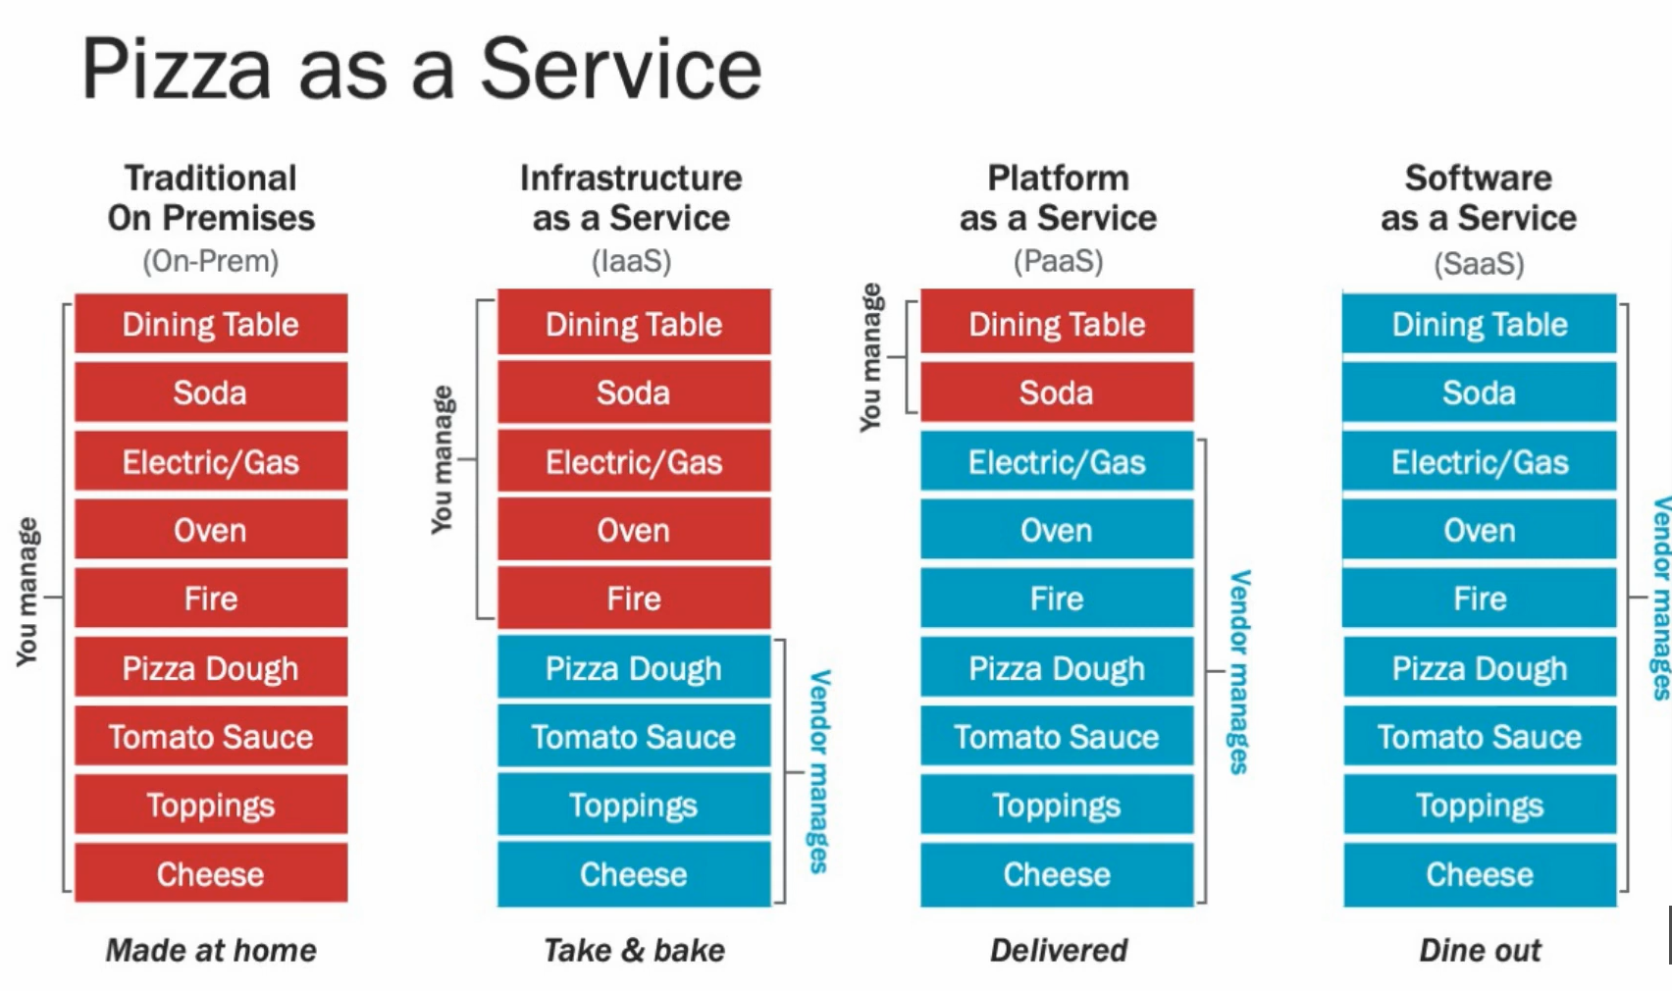

Slide 10
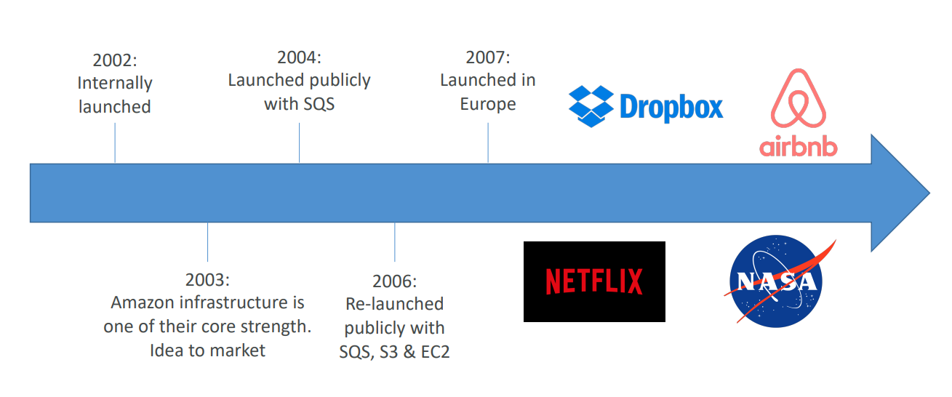
AWS Cloud History

Slide 11

AWS Cloud Use Cases
Applicable to a diverse set of industries
Use cases include
• Enterprise IT, Backup & Storage, Big Data analytics
• Website hosting, Mobile & Social Apps
• Gaming

Slide 12
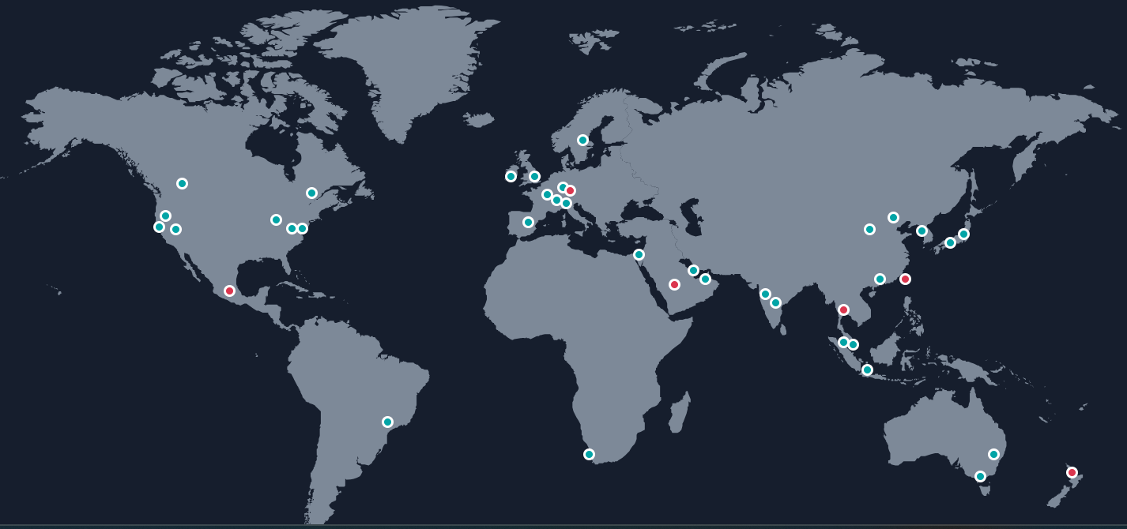
AWS Global Infrastructure
AWS Regions
AWS Availability Zones
AWS Data Centres
AWS Edge Locations /
Points of Presence
Local Zones
https://aws.amazon.com/about-aws/global-infrastructure

Slide 13
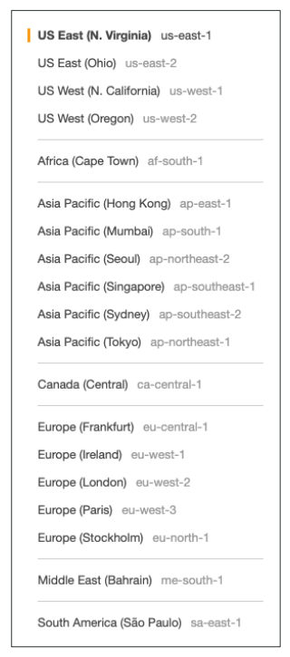
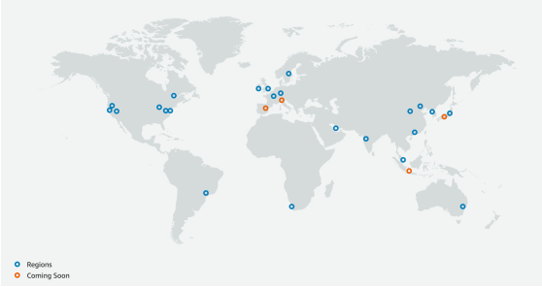
AWS Regions
AWS has Regions all around the world
Names can be us-east-1, eu-west-3…
A region is a cluster of data centers
Most AWS services are region-scoped

Slide 14
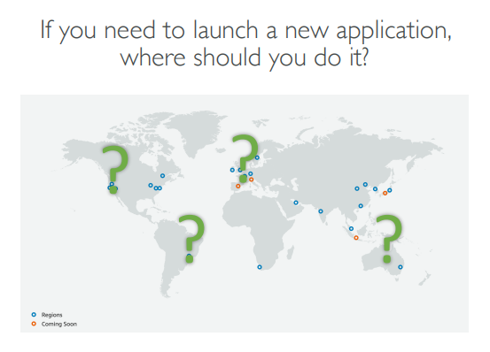
How to choose an AWS Region?
Compliance with data governance and
legal requirements: data never leaves a
region without your explicit permission
Proximity to customers: reduced latency
Available services within a Region: new
services and new features aren’t available
in every Region
Pricing: Differs from region to region

Slide 15
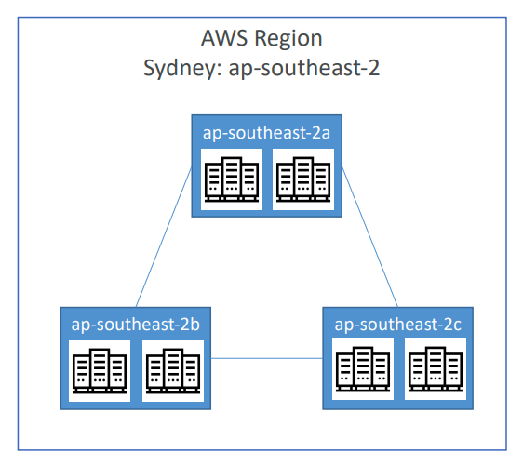
AWS Availability Zones
Each region has many availability zones
(usually 3, min is 3, max is 6). Example:
• ap-southeast-2a
• ap-southeast-2b
• ap-southeast-2c
Each availability zone (AZ) is one or more discrete
data centers with redundant power, networking,
and connectivity
They’re separate from each other, so that they’re
isolated from disasters
They’re connected with high bandwidth, ultra-low latency networking

Slide 16
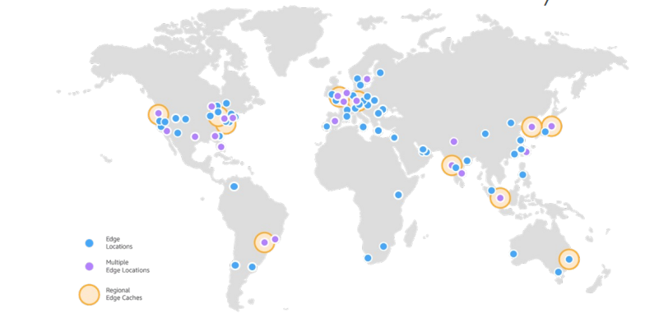
AWS Points of Presence (Edge Locations)
Amazon has 600+ Points of Presence (600+ Edge Locations & 13+ Regional Caches) in 90+ cities across 40+ countries
Content is delivered to end users with lower latency

Slide 17
AWS Local Zones
Amazon has 41 local zones & 29 wavelength zones for ultra low latency applications
Local zones are connected to parent region
Local zones place compute, storage, DB and other selected AWS services closure to end users
A Local zone cannot be included in a multi-AZ deployment

